Slide 1
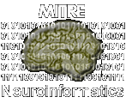
Why Can’t We All Just Share?
Ken Smith
The MITRE Corporation
(kps@mitre.org)

Slide 2
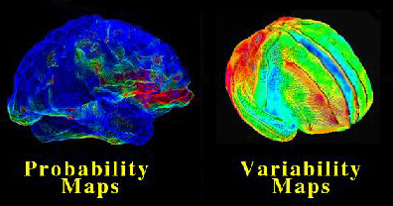
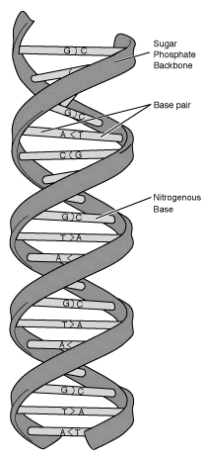


Sharing Can Be Really Good!
Notes:
1) It is a major challenge to operate without significant disruption for long periods of time when the data model, data formats, and constraints on data are evolving. The goal is to provide users the illusion that little has changed when the system gracefully handles the changing details.
2) Current DBMS technology does not manage objects with many parts of different types in an integrated fashion. For example, if you have text with an image, the text and the image are typically stored separately, indexed separately, queried separately... despite the fact that they are an integrated whole.
3) Query-by-example greatly extends a user’s ability to search for complex feature-rich objects by simply providing an example and asking the system to find similar items. This is inherently different from a more exact type of “boolean” search DBMS’s implement today. Boolean search could make sense after one has studied the results of a find-similar query.
4) Other common topics: non-traditional warehouse architectures, detection of trends and outliers.

Slide 3
A Four Dimensional Space of Open Issues ...
Must Solve
Problems in:
big win
1) Scope of
Intended
Visibility
public,
detailed,
reconciled,
available
policy,
info extraction,
integration,
infrastructure
data that
doesn’t
share well
4) Accessibility
3) Sender-Reciever
Homogeneity
private,
non-specific,
customized,
inaccessible
2) Quality of
Annotation
Notes:
Derived to address data sharing in this community (NIH) - outgrowth of emerging data sharing policies NIH will set (MITRE contributed / impacted)

Slide 4
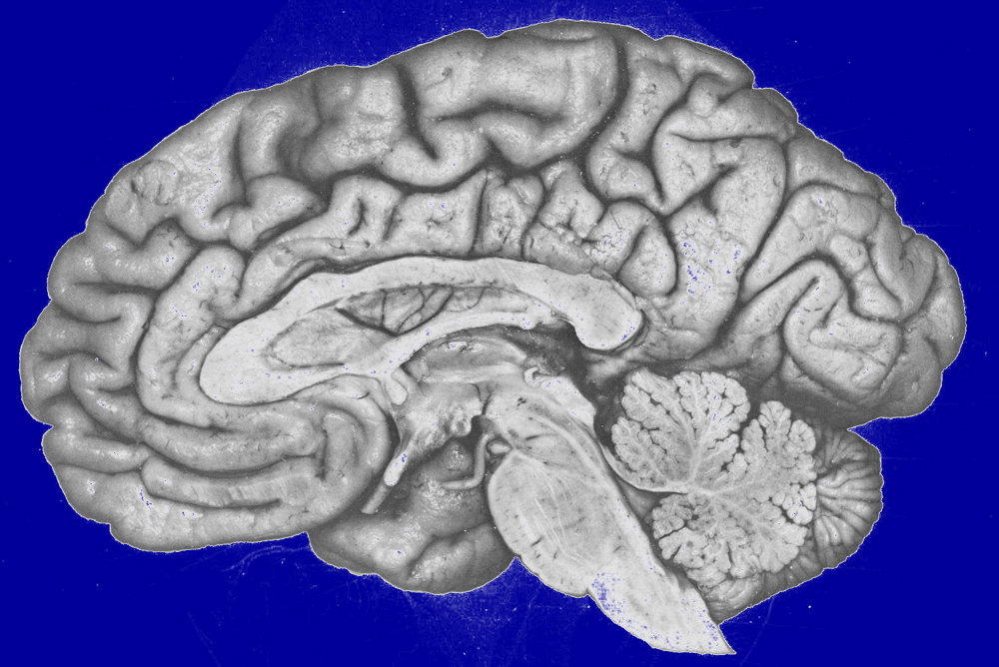
A Data Sharing Story
Laboratory A
Laboratory B
year 3
algorithms
??
year 5
25 subjects over 4 years,
400 Alzheimers images
Laboratory C
Laboratory D
Laboratory E
year 8
Alzheimer’s
Research
Community
10 images
Internet
Notes:
data visibility tends to increase incrementally with time and events (e.g. publications)
data visibility is associated with the perception of risk
data visibility centers on specific communities at specific times

Slide 5
Some Reflections . . . .
How can PI_{A} unambiguously express, communicate, and incrementally evolve his sharing intent?
  in what language?
  (must be simple yet expressive)
How can the described sharing be implemented and enforced (in new environments) without a heroic effort by PI_{A}
  who has other things to do with his time involving neuroscience!
What role does a local lab database play? Public databases? Email? Webservers? P2P tools?
  what tools are used?
  (must work well with what exists)
Notes:
1) It is a major challenge to operate without significant disruption for long periods of time when the data model, data formats, and constraints on data are evolving. The goal is to provide users the illusion that little has changed when the system gracefully handles the changing details.
2) Current DBMS technology does not manage objects with many parts of different types in an integrated fashion. For example, if you have text with an image, the text and the image are typically stored separately, indexed separately, queried separately... despite the fact that they are an integrated whole.
3) Query-by-example greatly extends a user’s ability to search for complex feature-rich objects by simply providing an example and asking the system to find similar items. This is inherently different from a more exact type of “boolean” search DBMS’s implement today. Boolean search could make sense after one has studied the results of a find-similar query.
4) Other common topics: non-traditional warehouse architectures, detection of trends and outliers.

Slide 6
What’s Needed (In Tools / Policy)
Communities (of all sorts) should be first-class citizens
Well-defined “channels” of information flow
?
?
?
Incremental degrees of visibility
Dynamic sharing coalitions (possibly many at once)
Simple, widely-understood expressions of sharing intent
Supports risk-management
Data owners want to be able to control their
exposure to risks as they share.

Slide 7


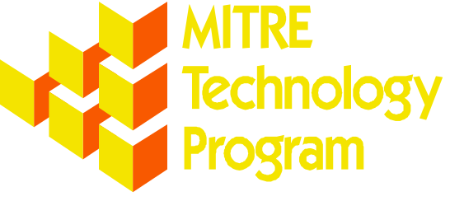
Thank You For Sharing These 5 Minutes With Me.
NIH / NIMH
URL: neuroinformatics.mitre.org

Slide 8
Backup Slides
Notes:
1) It is a major challenge to operate without significant disruption for long periods of time when the data model, data formats, and constraints on data are evolving. The goal is to provide users the illusion that little has changed when the system gracefully handles the changing details.
2) Current DBMS technology does not manage objects with many parts of different types in an integrated fashion. For example, if you have text with an image, the text and the image are typically stored separately, indexed separately, queried separately... despite the fact that they are an integrated whole.
3) Query-by-example greatly extends a user’s ability to search for complex feature-rich objects by simply providing an example and asking the system to find similar items. This is inherently different from a more exact type of “boolean” search DBMS’s implement today. Boolean search could make sense after one has studied the results of a find-similar query.
4) Other common topics: non-traditional warehouse architectures, detection of trends and outliers.

Slide 9
Data Sharing Sure Has Gotten A Lot of Attention Lately
Share Freely!
No You Don’t!
Millions of teenagers, their favorite music, and KaZaA
Homeland security, total information awareness (TIA), fighting terrorism
Medical research records, funding agencies, finding a cure for Alzheimers
The Recording Industry Association of America (RIAA) and lawsuits
The Electronic Frontier Foundation (EFF), US Newsmedia, individuals
The health insurance portability and accountability act (HIPAA), faculty concerned about getting scooped
  Societal behemouths are on a collision course over data sharing issues
Notes:
While the ICBM has a clear vision of their neuroscientific goals and are intimately familiar with the experimental techniques used to map the human brain, the skills necesssary to organize and make accessible all of this data to the global neuroscience community is beyond the scope of their expertise and interest.
Currently a number of roadblocks exist:
(* read through list of roadblocks *)
I’ll point out that none of these items have any neuroscience jargon embedded in them, and that this list could readily be applied to a number of our traditional sponsors. Research in a number of these areas would build expertise that would likely be generally applicable to problems faced by our traditional sponsor base.

Slide 10
Reflections on this Story
Lessons about data visibility:
  data visibility tends to increase incrementally with time and events (e.g. publications)
  data visibility is associated with the perception of risk
  data visibility centers on specific communities at specific times
Questions about realizing this scenario:
  How can PI_{A} unambiguously express, communicate, and incrementally evolve his sharing intent?
  How can the described sharing occur without a heroic effort by PI_{A}?
  What role does the local database play? Public databases? Peer-to-peer sharing tools? In general, how is sharing intent implemented in real systems??
Data owners want to be able to control their
exposure to risks as they share.
Notes:
1) It is a major challenge to operate without significant disruption for long periods of time when the data model, data formats, and constraints on data are evolving. The goal is to provide users the illusion that little has changed when the system gracefully handles the changing details.
2) Current DBMS technology does not manage objects with many parts of different types in an integrated fashion. For example, if you have text with an image, the text and the image are typically stored separately, indexed separately, queried separately... despite the fact that they are an integrated whole.
3) Query-by-example greatly extends a user’s ability to search for complex feature-rich objects by simply providing an example and asking the system to find similar items. This is inherently different from a more exact type of “boolean” search DBMS’s implement today. Boolean search could make sense after one has studied the results of a find-similar query.
4) Other common topics: non-traditional warehouse architectures, detection of trends and outliers.

Slide 11

Isn’t Data Sharing just a Policy Issue?
(i.e. Non-informatic)
2) Their clear expression
in a language (Encoding)
dklaoiek akfdj adkdk dkdk akdoaoiedn d d dkdkdk da093 4mcz 39jfd0 d93lk dda[09emlk akd93j aiksd[09 akd90 akdoi a30b
3) Their execution
in a computerized
system capable of
sharing data
(Automated Enforcement)
1) The data owner/
shepherd’s sharing
intentions (Policy)
  Data sharing involves computerized systems which must “understand” the data owner’s intent
Notes:
1) Access control policy is determined by consulting the parties who can impose constraints on access and formulating appropriate roles and access rules. A good policy can be easily stated and understood, and thus determined to be correct/consistent with law, and correctly mapped onto an enforcement mechanism. When the set of constraints grows beyond what is cognitively tractable, this task becomes extremely difficult.
Any policy must be enforced. DBMS products provide some useful tools (e.g. roles), but many policies exceed those features and new enforcement strategies must be produced.
2) As types of information are gathered (e.g. brain scans, tax compliance records) for which privacy concerns are sensitive and/or have not been well considered, violations of privacy guarantees are increasingly possible. This danger grows as information is combined into new and larger stores (the “aggregation problem”). However simply prohibiting the gathering/combining of information defeats benficial utility of such information.

Slide 12
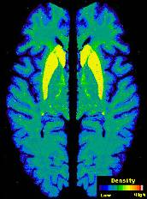
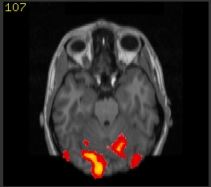
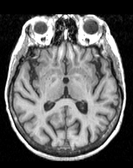
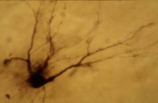
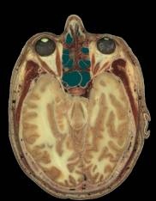

What is Neuroimagery?
Notes:
I’d like to give you a sense for the scope of the data being gathered by the ICBM.
1) At the heart of their effort is structural Magnetic Resonance Imaging data, having roughly 1cubic mm spatial resolution Each of the participating labs are gathering this type of data, along with a rich body of associated metadata that captures substantial information about the subjects medical and personal background.
2) They are also banking blood samples for a large number of their subjects and storing these for subsequent DNA analysis
3) A number of the labs are involved in clinical work and are able to gather data from single neurons in the human brain, this only happens in special cases where such recording is done prior to surgical treatment for epilepsy.
4) Two of the labs are involved in cryosection data from post mortem tissue, where Each brain is frozen and then sliced into roughly 100 micron sections. Depending on how finely things are imaged (corresponding to the objective on the microscope), this can create data volumes from 60 gigabytes to almost a terabyte for one brain.
5) These same labs are involved in processing these cyro-sections to determine the spatial distribution of candidate proteins, here the dopamine transporter localized in the striatum
6) The majority of the labs are involved in functional methods such as PET and fMRI to determine the locations of the brain where rCBF is is high, this provides an indication what neural populations are active during some cognitive, motor, or perceptual task.
7) The ICBM EEG and MEG techniques to get the temporal dynamics of brain processes w/ millisecond resolution
8) All are involved in behavioral tasks. These will allow the other variables to be correlated with overall performance on perceptual, cognitive and motor tasks.
This is a vast amount of data at the macro and micro levels.
We will be focusing on providing support for the structural MRI data initially, but hope to eventually extend the system to cover each of these sensing modalities.

Slide 13
Why Share Neuroimagery?
“Large N” results
  key scientific results are unobtainable with the images any single lab is likely to possess
Peer-to-peer collaboration for mutual publication
  “A” has the data, “B” has the algorithms
Obligation to funding source
  funding agencies want the biggest “bang for their buck”
Altruism
  extend usefulness of unusual or hard-won datasets, and benefit the field as a whole, and poorer labs in particular
Notes:
1) It is a major challenge to operate without significant disruption for long periods of time when the data model, data formats, and constraints on data are evolving. The goal is to provide users the illusion that little has changed when the system gracefully handles the changing details.
2) Current DBMS technology does not manage objects with many parts of different types in an integrated fashion. For example, if you have text with an image, the text and the image are typically stored separately, indexed separately, queried separately... despite the fact that they are an integrated whole.
3) Query-by-example greatly extends a user’s ability to search for complex feature-rich objects by simply providing an example and asking the system to find similar items. This is inherently different from a more exact type of “boolean” search DBMS’s implement today. Boolean search could make sense after one has studied the results of a find-similar query.
4) Other common topics: non-traditional warehouse architectures, detection of trends and outliers.

Slide 14
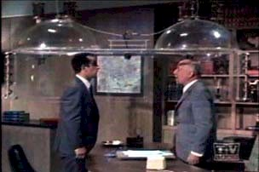
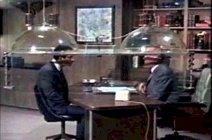
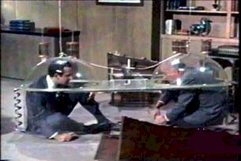
What Is Sharing?
Privacy
  “Seclusion or isolation from the view of, or from contact with, others” (Websters)
  A relational sphere of trust and immunity from external intrusion, encompassing people and information (personal)
Data Sharing
  Voluntary disclosure of privately-held information
Implication: for sharing to occur, the perceived benefits
of disclosure must outweigh the perceived risks
Notes:
1) It is a major challenge to operate without significant disruption for long periods of time when the data model, data formats, and constraints on data are evolving. The goal is to provide users the illusion that little has changed when the system gracefully handles the changing details.
2) Current DBMS technology does not manage objects with many parts of different types in an integrated fashion. For example, if you have text with an image, the text and the image are typically stored separately, indexed separately, queried separately... despite the fact that they are an integrated whole.
3) Query-by-example greatly extends a user’s ability to search for complex feature-rich objects by simply providing an example and asking the system to find similar items. This is inherently different from a more exact type of “boolean” search DBMS’s implement today. Boolean search could make sense after one has studied the results of a find-similar query.
4) Other common topics: non-traditional warehouse architectures, detection of trends and outliers.

Slide 15
An Overview of the Risks Of Sharing Neuroimagery (Result of an Informal Survey)
Information theft risks
  scooped results; uncited sources; mass downloads; uncompensated commercial use; vengeful deanonymization
Information abuse risks
  insurance denial; shared form of data altered; data misunderstood and improperly reused; reuse for purposes opposed by the subject (e.g racism)
Loss of time and effort risks
  besieging questions from colleagues; cost of learning data sharing tools; cost of compliance with complex regulations.
Subject privacy risks
  shared data no properly deanonymized; shared data is found to violate HIPAA resulting in a financial penalty or in a prison term.
Each domain has its characteristic sharing risks.
Notes:
1) It is a major challenge to operate without significant disruption for long periods of time when the data model, data formats, and constraints on data are evolving. The goal is to provide users the illusion that little has changed when the system gracefully handles the changing details.
2) Current DBMS technology does not manage objects with many parts of different types in an integrated fashion. For example, if you have text with an image, the text and the image are typically stored separately, indexed separately, queried separately... despite the fact that they are an integrated whole.
3) Query-by-example greatly extends a user’s ability to search for complex feature-rich objects by simply providing an example and asking the system to find similar items. This is inherently different from a more exact type of “boolean” search DBMS’s implement today. Boolean search could make sense after one has studied the results of a find-similar query.
4) Other common topics: non-traditional warehouse architectures, detection of trends and outliers.

Slide 16
A Label- based Model for Data Sharing
Each class is a COI (community of interest)
  users sharing a common task and using common data
  data, users are labeled with their COI, and can access all data in their COI
Dominance entails set membership:
  If person P ∈ COI₁ and COI₁ dominates (belongs to) COI₂, then P ∈ COI₂
  Thus, one can “read down”
“Lower” classes offer more visibility (and risk)
  information flows downward over time
null (top)
Lab A
Lab B
Lab C
Peer
A-B
Research
Group 1
Research
Group 2
internet

